Slide 1

1. REGULAR TOOLS
MAIL
TELEGRAM
MICROSOFT WORD
TEAMWORK
GOOGLE DRIVE FILE STREAM
2. DEVELOPERS & QA TOOLS
3. LEARNING COMPANY IDEA

Slide 2
GSUITE– ALADINTECH.CO
G-Drive
Mail
Install on PC: Outlook or Thunderbird.
Install on Mobile: Gmail.
Response Quickly.
Outbound mails must include the manager.
Training Document: “Training”
Gmail
Telegram
G-Sheet
G-Doc

Slide 3
TELEGRAM
Install on PC: https://telegram.org/
Install on Mobile:android or iPhone.
Company Group: AladinCompany, DevAladin, private groups…
Quickly Response.

Slide 4
MICROSOFT WORD
Table of Contents
Comments
Embedded Documents- Tài liệu nhúng
Formal Document: Header, Footer, Waterfall, Table Of Contents.

Slide 5
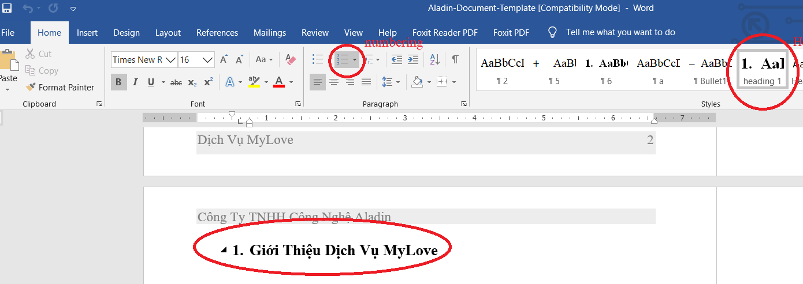
USING HEADING, NUMBERING.

Slide 6
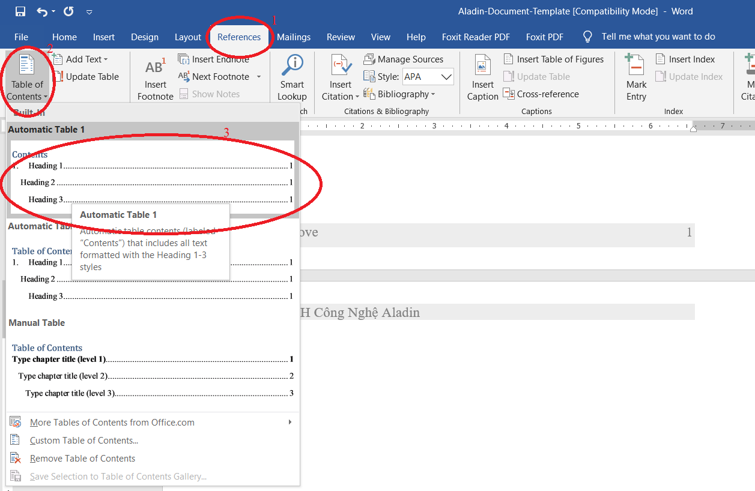
MENU: REFERENCE ->TABLE OF CONTENTS.

Slide 7
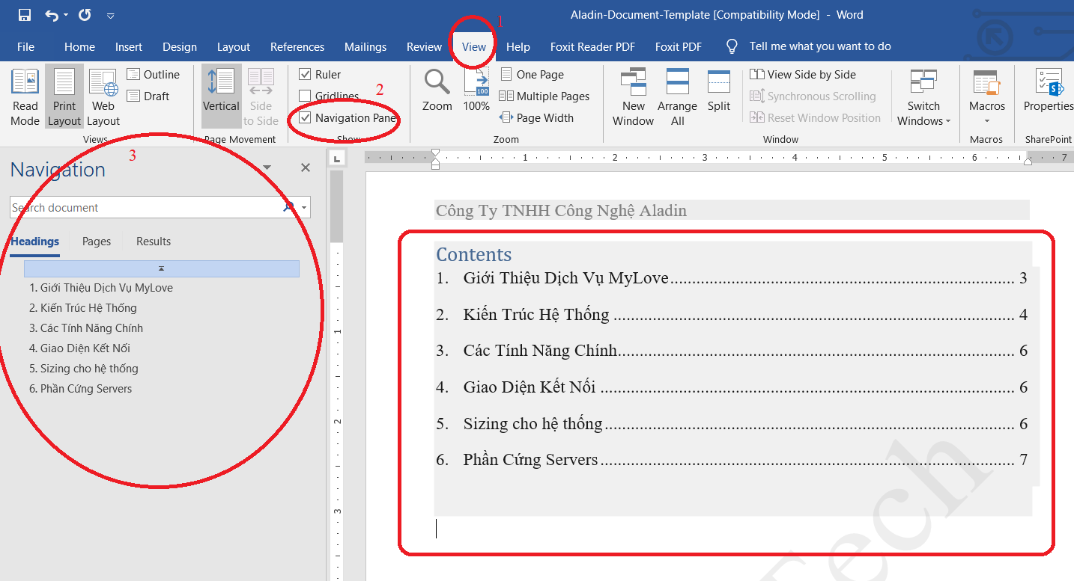
TABLE OF CONTENTS

Slide 8
EXAMPLE
Aladin – Training Directory: https://drive.google.com/open?id=1kzfmVDPwp17t4ZBqZbwGOyym0onEbqfm
Aladin-Document-Template.docx

Slide 9
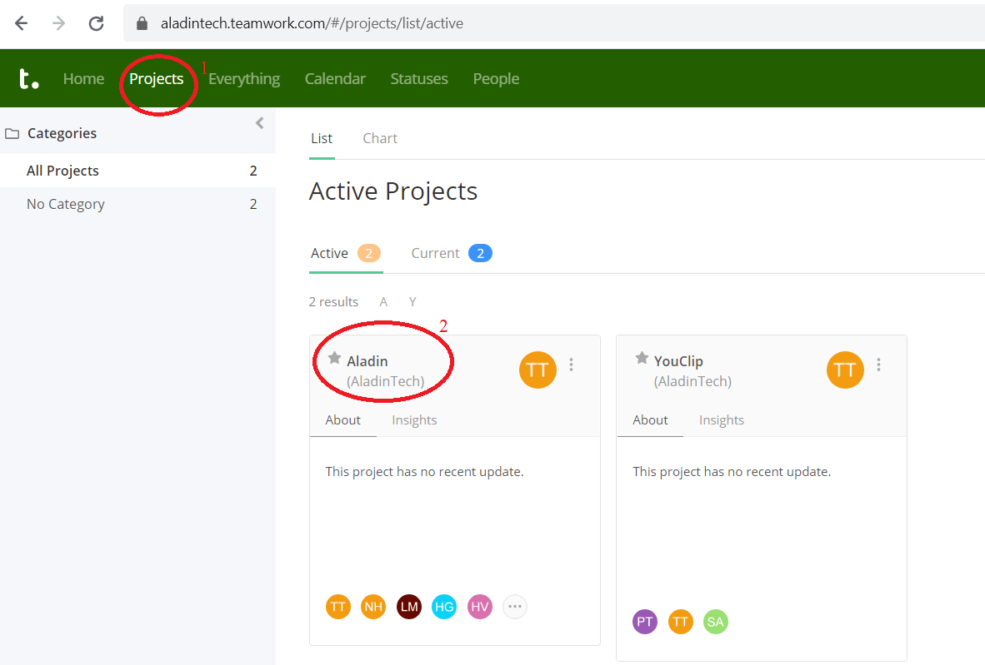
TEAMWORK - PROJECT

Slide 10
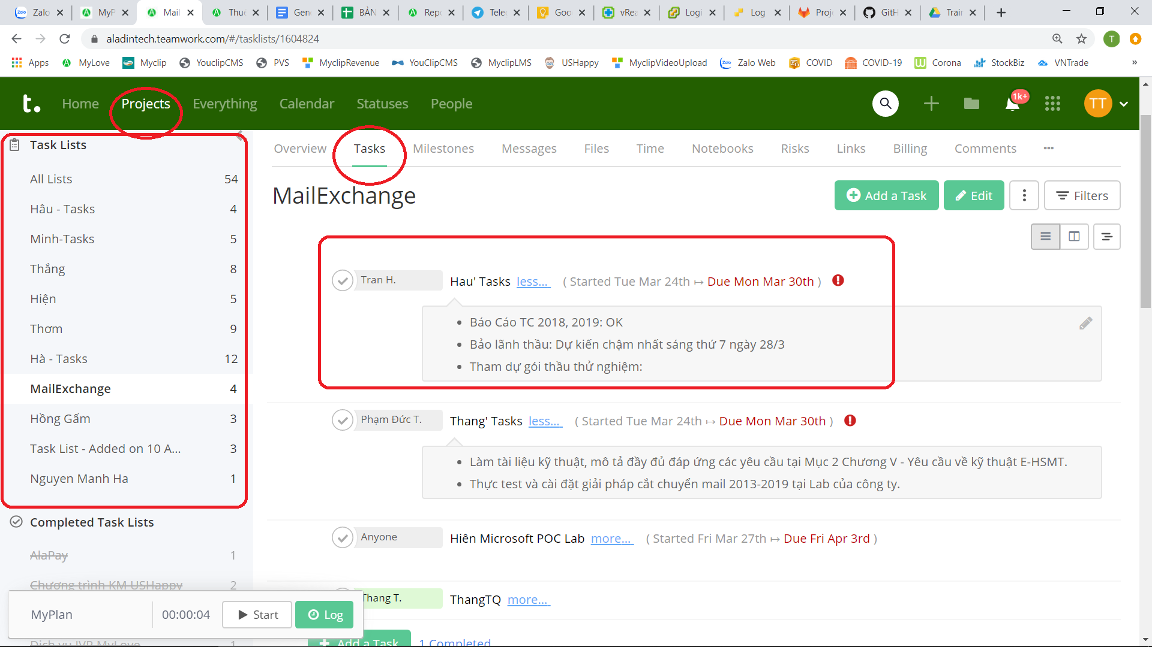
TEAMWORK - TASKLIST

Slide 11
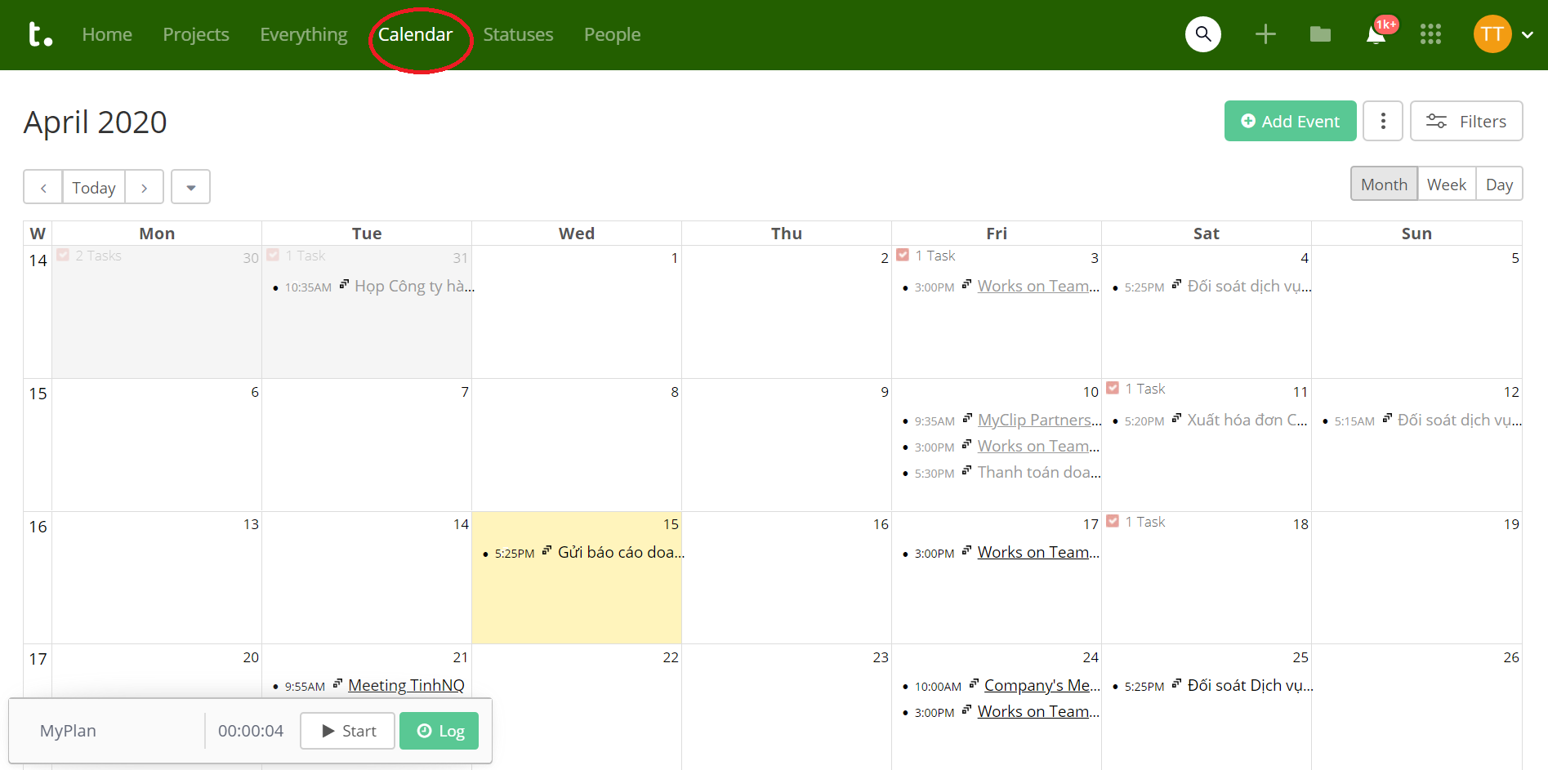
TEAMWORK - CALENDAR

Slide 12
TEAMWORK - PRACTICE
Updating on Friday every week.
Demo creating a task.

Slide 13
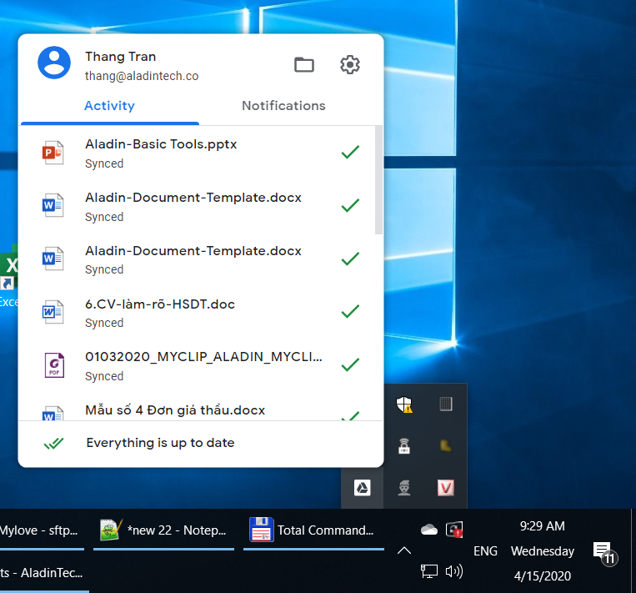
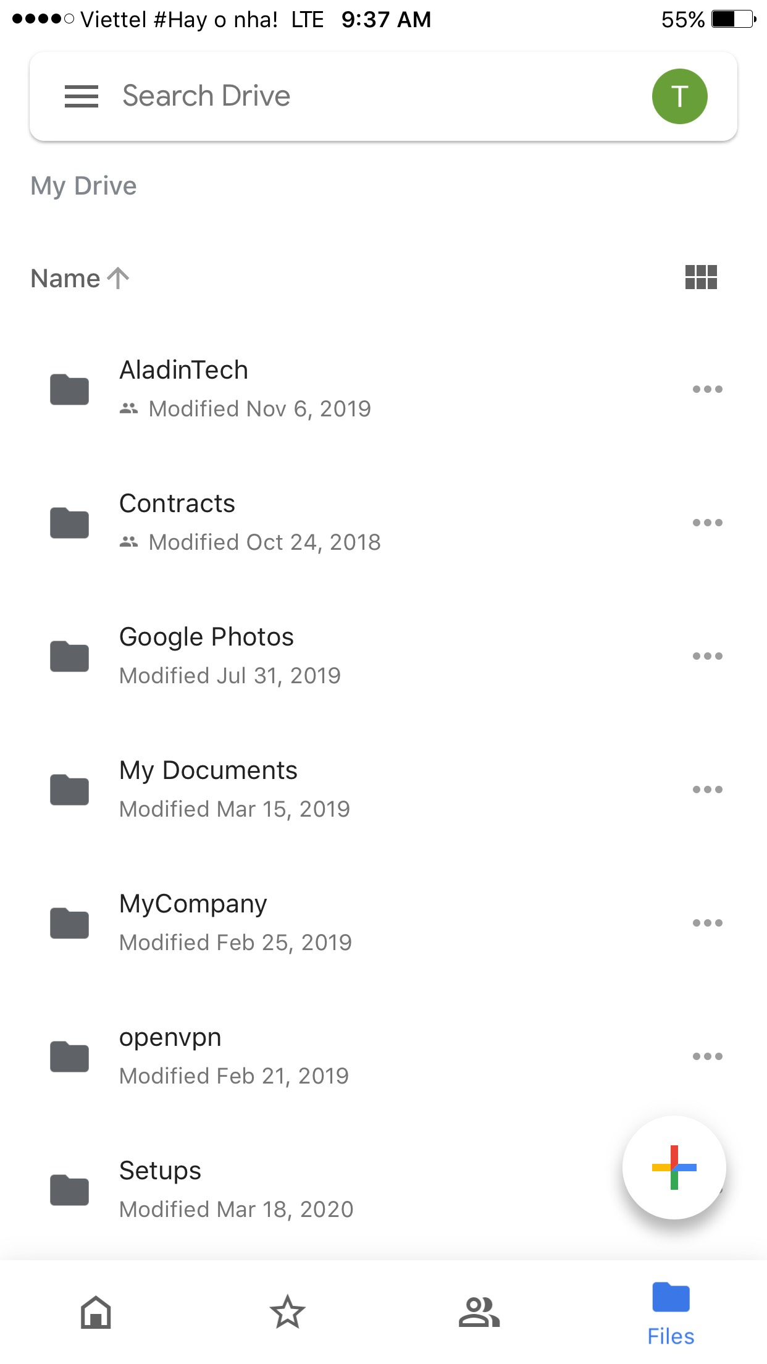
GOOGLE DRIVE FILE STREAM
Download : https://dl.google.com/drive-file-stream/GoogleDriveFSSetup.exe on PC, ‘Google Drive’ on mobile
Working every where, any time: on mobile, Home , Company…

Slide 14
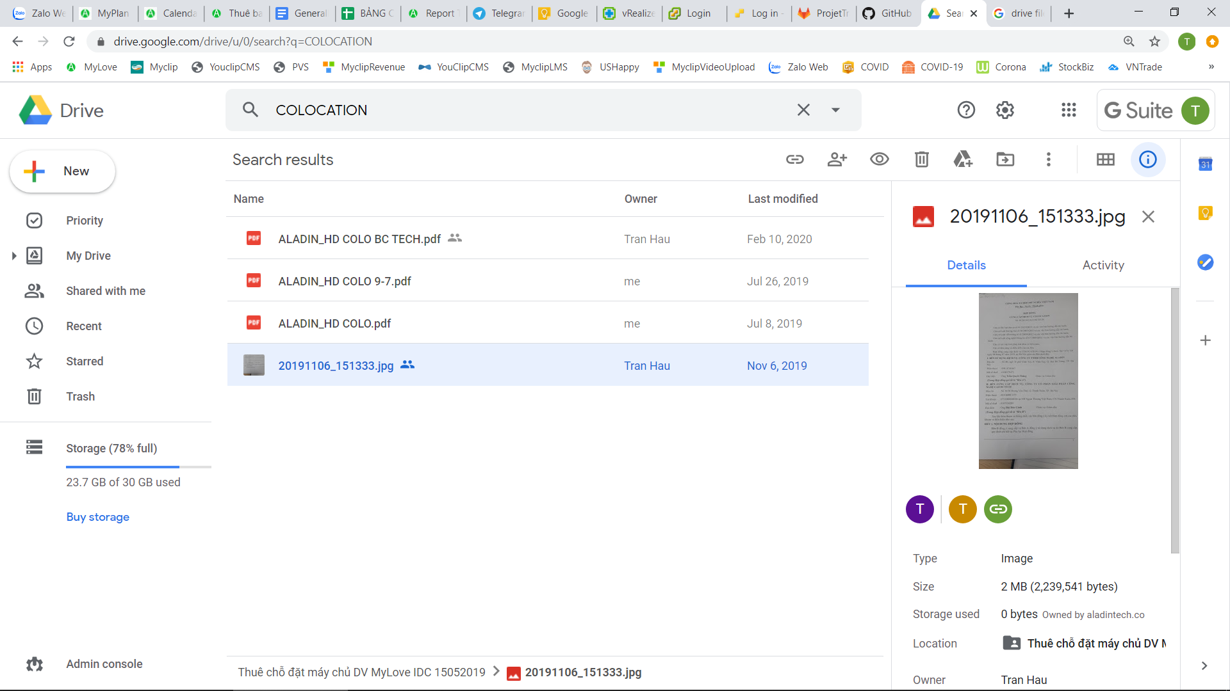
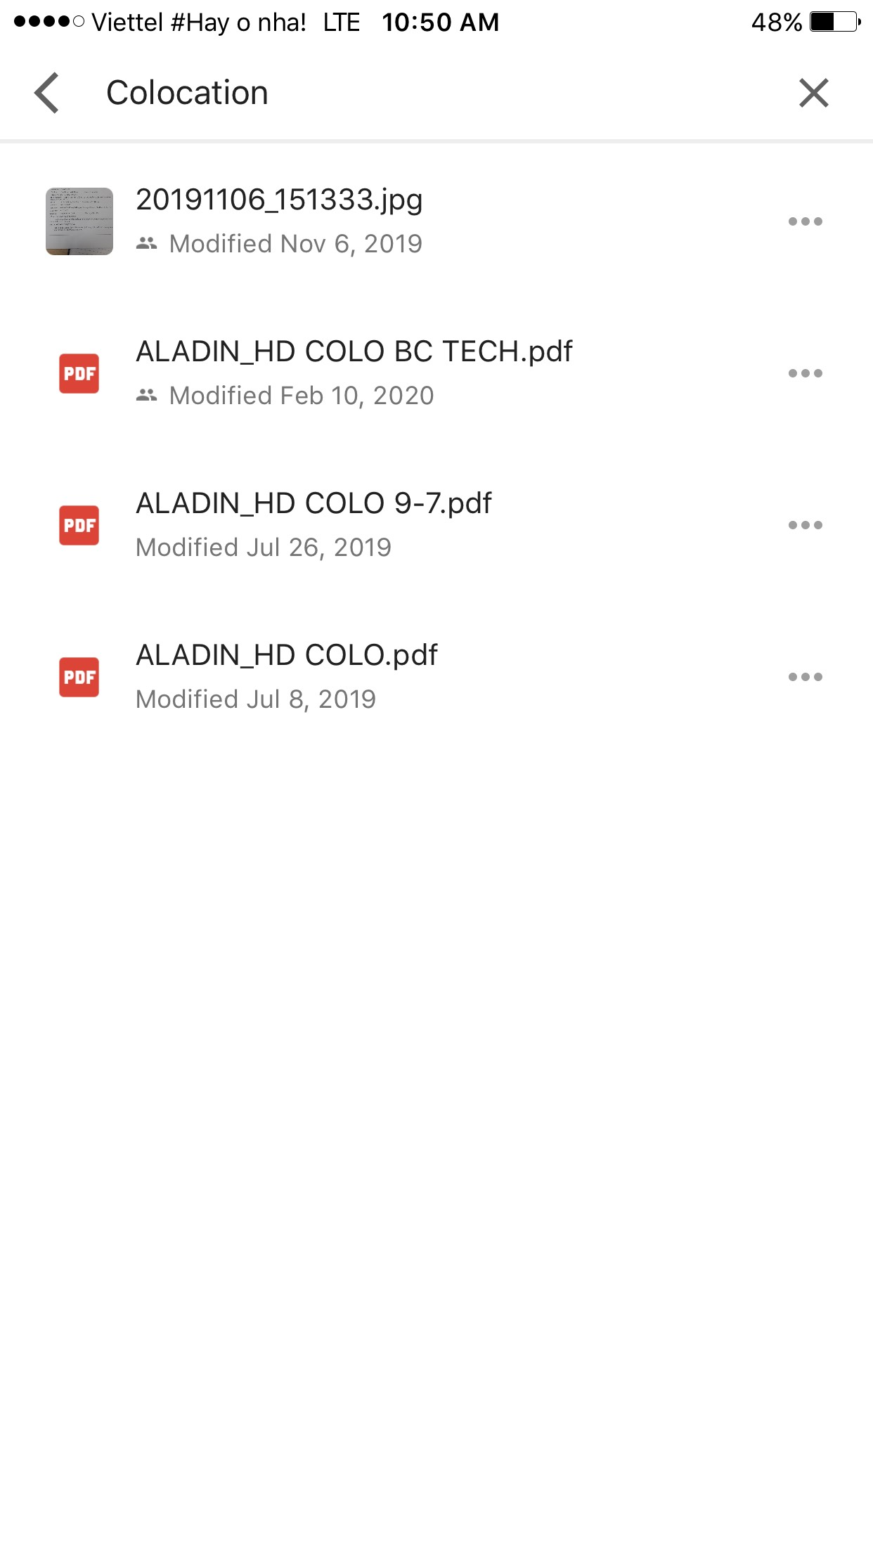
GOOGLE DRIVE FILE STREAM - SEARCHING
PC
MOBILE

Slide 15
DEVELOPERS & QA TOOLS
Tool | Description | Must Use
Teamwork | managing works and tasks | Dev & QA
Google drive file stream | sharing files | Dev & QA
Xshell & Common linux commands | for managing, deploying apps to linux OS systems. | Dev & QA
Gitlab | managing documents & source code. | Dev & QA
SqlDeveloper | excuting SQL queries to Oracle Database. | Dev & QA
FileZilla Client | upload/download files to/from linux OSs. | Dev & QA
Postman | test manual & automation APIs. | Dev & QA
TestComplete | testing automation for Web. | QA
Intellij | Coding | Dev
Netbean | Coding | Dev

Slide 16
LEARNING COMPANY - IDEA
One training per week regarding to regular works, knowledge, English…
Presentation: 10-20 pages, 1 - > 1.5h.
Improving Soft Skills: study, communication, self-confident….

Slide 17
Q&A

